Slide 1
TECHCRUSH FINAL CAPSTONE PROJECT | GROUP 12
Restoring Supply, Rebuilding Trust
Riverside Power Distribution Company: what we found, what we recommend, and how to start. A compilation of Tracks A to D.
Presenter: Mr. David Yerima
October 2026
Notes:
Welcome and introduce the group. This deck summarises four tracks of work on Riverside Power: discovery, data analysis, process redesign and requirements with the business case.

Slide 2
Riverside is losing on service, revenue and regulation at once
118,000
11.2 hrs
54%
₦2.4bn
complaints a month
average outage
restored in target
revenue lost a year
was 42,000
was 4.8 hrs
standard is 90%
two industrial customers
Also on the table: compensation claims up 340%, and a proposed ₦6.8bn investment that has not been tested against the data.
Notes:
Open with the scale of the problem. Complaints nearly tripled, outages more than doubled in length, and NERC has issued a compliance notice.

Slide 3
Four tracks, five deliverables
A
B
C
D
Requirements and BRD
Process mapping
Data and dashboard
Business case and Jira
Deliverable 5
Deliverable 2
Deliverable 3
Deliverables 4 and 1
Stakeholder analysis, 200-customer survey, NVivo themes, requirements
AS-IS and TO-BE outage process flows, bottlenecks and gaps
10,000 outage records, dashboard, hypothesis tests
Option costs, alternatives, roadmap, risks, activity tracking
13 pairs | Team Lead: Okolo Henry Ugochukwu | Deputy Team Lead: Vera Chioma Onovo
Notes:
Walk through the tracks quickly. Each track owned a deliverable, and every finding traces back to evidence. 13 pairs worked under Team Lead Okolo Henry Ugochukwu and Deputy Team Lead Vera Chioma Onovo.

Slide 4
Track A: three in four customers are dissatisfied
What stands out
Industrial customers are the angriest: 87% unhappy with repeat reporting, 82% with communication.
Financial loss is the top impact (41%).
What would help most: fewer outages (32.5%) and faster restoration (31.5%).
Notes:
Between 71 and 77 percent are dissatisfied on all six questions. Communication and repeat reporting are the worst. Source: raw survey file, n=200.

Slide 5
Track A: leaders and customers want the same thing
Leaders (5 themes, 10 stories)
Customers (2 themes, 11 stories)
Lift the NERC compliance notice
Keep industrial customers on the grid
Test the ₦6.8bn plan against data
Deploy field crews better across 8,400 km of lines
Stop "flying blind": telemetry for the control room
Stable, predictable supply
Less reliance on diesel generators
Realistic restoration estimates
Details logged right the first time
No chasing staff for updates
Notes:
NVivo coding produced 5 stakeholder themes with 10 user stories, and 2 customer themes with 11 user stories.

Slide 6
Track A: every requirement traces to an objective
7
12
15
10
business objectives
business requirements
functional requirements
stakeholder requirements
Headline targets
NERC compliance (BO-1) 54% → 90% restored in target
Duration (BO-2) 11.2 hrs → toward 4.8 hrs, phased
Complaints (BO-3) 118,000 → toward 42,000, de-duplicated
Evidence-based spend (BO-6) 0% → 100% traceable
Notes:
Seven business objectives drive all requirements. Priorities use MoSCoW.

Slide 7
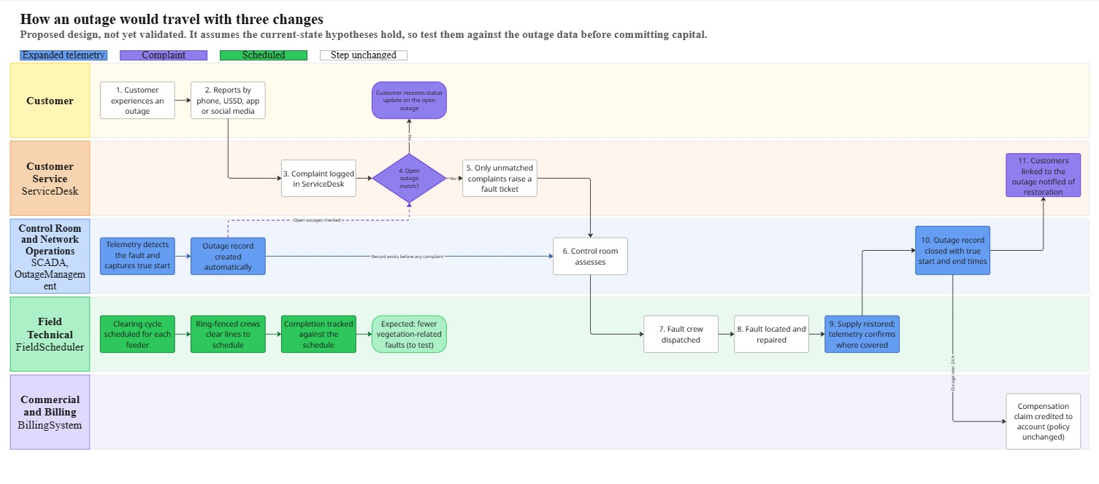
Track B: three changes to how an outage travels
Expanded telemetry
Alert and outage record before any complaint
Complaint matching
Link to the open outage; handle once
Scheduled clearing
Ring-fenced crews, tracked schedule
Also: dispatch rules, electronic completion times and automatic restoration notices.
Today: 11 steps, five groups, three critical gaps. See Document 3 for the AS-IS map.
Notes:
The to-be map is a proposed design, not validated. Each change has a measure so the Board can test it.

Slide 8
Track C: no single cause explains the outages
16.99%
of incidents are transformer failures
Mean time to restore is 8.95 to 9.19 hours whichever cause, and areas differ by only 7%. The problem is shared across the system.
Notes:
Every cause sits between 16.1 and 17.0 percent. Transformer failure is 16.99 percent, so the 6.8bn transformer programme would address about one outage in six.

Slide 9
Track C: faults are found late, then wait 3.5 hours
49.5%
found by crews or customers, not systems. 58 of 96 substations have no telemetry.
39%
of the average outage is spent waiting for dispatch: 210.7 of 543 minutes.
Notes:
Nearly half of outages are found by crews or customer calls. Dispatch averages 210.7 minutes, about 39 percent of the 9.05 hour average outage.

Slide 10
Track C: we tested beliefs before building on them
We need new transformers
Not supported as main driver
The vegetation cut caused this
Unproven; fix cheaply and measure
Duplicate reports inflate complaints
Plausible; cannot be sized yet
We need more field staff
Not shown; fix dispatch first
Faults are detected too late
Supported
Notes:
Each belief was treated as a hypothesis. Only the detection gap is clearly supported. Others need feeder-level data before they can be settled.

Slide 11
Track D: Option B costs an eighth of Option A
 | Option A | Option B
Running cost / yr | ₦150m | ₦320m
Cause coverage | 16.99% | All causes
Payback | 12+ years | < 6 months
5-year NPV | Negative | Positive
Treat as directional. Not verified by Finance and not yet split by intervention. Option B has the higher running cost, and both cross the ₦500m shareholder and NERC threshold as bundled.
Notes:
These figures are illustrative and have not been verified by Finance. The BRD requires verification before any figure goes into a Board paper.

Slide 12
Track D: four alternatives compared
Do nothing
Losses, complaints and NERC exposure keep building
Option A: transformer refit
₦6.8bn; covers 16.99% of incidents; hold for per-asset cases
Option B: telemetry and integration
₦850m; targets detection, dispatch, records across causes
Staged approach
Option B first, then each asset case on its own (recommended)
Project tracking: all pair activity logged on the Jira board (Deliverable 1).
Notes:
Do nothing is not neutral: industrial losses and NERC exposure keep building. Option A addresses 16.99 percent of incidents. Option B covers all causes. Our recommendation is Option B first, then each asset case on its own. The Jira board, Deliverable 1, tracked all of this work.

Slide 13
Track D: a twelve-month plan in four phases
Months 1 to 3
Months 4 to 6
Months 7 to 9
Months 10 to 12
Procure and design
Telemetry and data
Field and customers
Audit and close
Telemetry units for priority substations; integration design
Install telemetry; live data feed; ticket de-duplication
Mobile field tools; vegetation schedule; customer notifications
Validate against target; NERC SLA audit; industrial retention report
Notes:
Timelines are illustrative and need confirming with Network Operations, the CIO and Procurement. Quick wins such as de-duplication and the vegetation schedule might be pulled earlier.

Slide 14
What we recommend, in order
1
Telemetry at priority substations
5
Automatic customer notification, industrial first
2
Link Service Desk to Outage Management; de-duplicate
6
Fix records: cause codes, timestamps, verified claims
3
Dispatch priority rules with audit trail
7
Hold the ₦6.8bn until each option is costed
4
Reinstate a risk-based vegetation schedule
Notes:
Seven recommendations. The last one holds the 6.8bn until each asset option has a costed case.

Slide 15
Decisions we need from the Board
Approve in principle
the phased programme, subject to Finance validation
Verify the numbers
Finance to confirm cost, benefit and payback per intervention
Engage NERC
confirm the deadline and agree a phased plan with milestones
Agree priorities
which of the 58 substations get telemetry first
Notes:
Close with the decisions. Be open that figures need Finance verification and that the NERC deadline must be confirmed.

Slide 16
Start with what the evidence supports
See faults sooner. Keep one record. Dispatch by rule. Clear the lines. Tell customers.
Thank you. Questions welcome. Group 12, TechCrush Final Capstone
Notes:
Close by repeating the five-part sequence and invite questions.

